Slide 1

Texas A&M International University
Budgets 101
Presented By:
Office of Budget, Payroll, and Fiscal Analysis
Notes:
make Intro
Manual promoting our website
Introduce attendees/sign in in the back
Evaluations
Thank you again for being here this morning. Feel free to ask questions
Is everyone comfortable-hot or cold ?

Slide 2
Office of Budget, Payroll, and Fiscal Analysis (BPFA)
Fred Juarez III, Director of BPFA
Budget
    Christy Martinez, Senior Budget Analyst
Payroll
    Nora Lerma, Payroll Analyst
    Denisse Garza, Payroll Analyst

Slide 3
Agenda
  Types of Fund Groups
  Budget Pools
  FAMIS/Canopy Screens
  Budget Transfers
  Object Codes
  Q&A

Slide 4
Types of Fund Groups
  Education and General (E&G)-State (1XXXXX)
  Designated Category (Local) (2XXXXX)
  Auxiliary Category (Local) (3XXXXX)
  Federal Grants (4XXXXX)
  Restricted- State, Local & Private Grants (5XXXXX)
  Gifts, Income, & Fundraisers
  Scholarships Accounts (6XXXXX)

Slide 5
Education and General (E&G)-State
  Account Range
    100000-199999
  Source of Funds
    State Appropriations
    State Tuition
  Special Allocations
    HEAF (141XXX)
    GIP (1210XX)

Slide 6
Designated Category (Local)
  Examples of Budgeted Fee Accounts (2XXXXX):
    Designated Tuition (Board Authorized Tuition)
    University Service Fee
    Student Service Fee
  Examples of Self-Supporting Accounts:
    Continuing Education
    Contingency Accounts
    Indirect Cost (Research or Non-Research)

Slide 7
Auxiliary Category (Local)
  Examples of Budgeted Fee Accounts (3XXXXX):
    Student Center Fee
    Health Fee
    Rec. Sports Fee
    Athletics Fee

Slide 8
Restricted
  Federal Grants and Contracts
    400000-499999
  State, Local, and Private Grants and Contracts
    500000-529999
  Self-Supporting Accounts
    530000-559999
    Gifts, Income, and Fundraising
  Scholarships
    600000-690000

Slide 9
Budget Pools
    Salaries 1100
    Wages 1700
    Benefits 1900
    Travel 3000
    Maintenance & 4000
Operations (M&O)
    Capital/Equipment 8000

Slide 10
FAMIS/Canopy
    Current information on all accounts is available through FAMIS and Canopy:
    FAMIS Canopy
      Account Budgets Sc. 34 ‘Summary’ Tab**
      Account Balances Sc. 19 ‘Summary’ Tab
      Transactions Sc. 46 ‘Transactions’ Tab
      Encumbrances Sc. 21 ‘Open Comm’ Tab
    **SL Display: Summary by Budget Pool
Please note: FAMIS User Id and Password is the same for Canopy Login (http://canopy.tamus.edu)

Slide 11
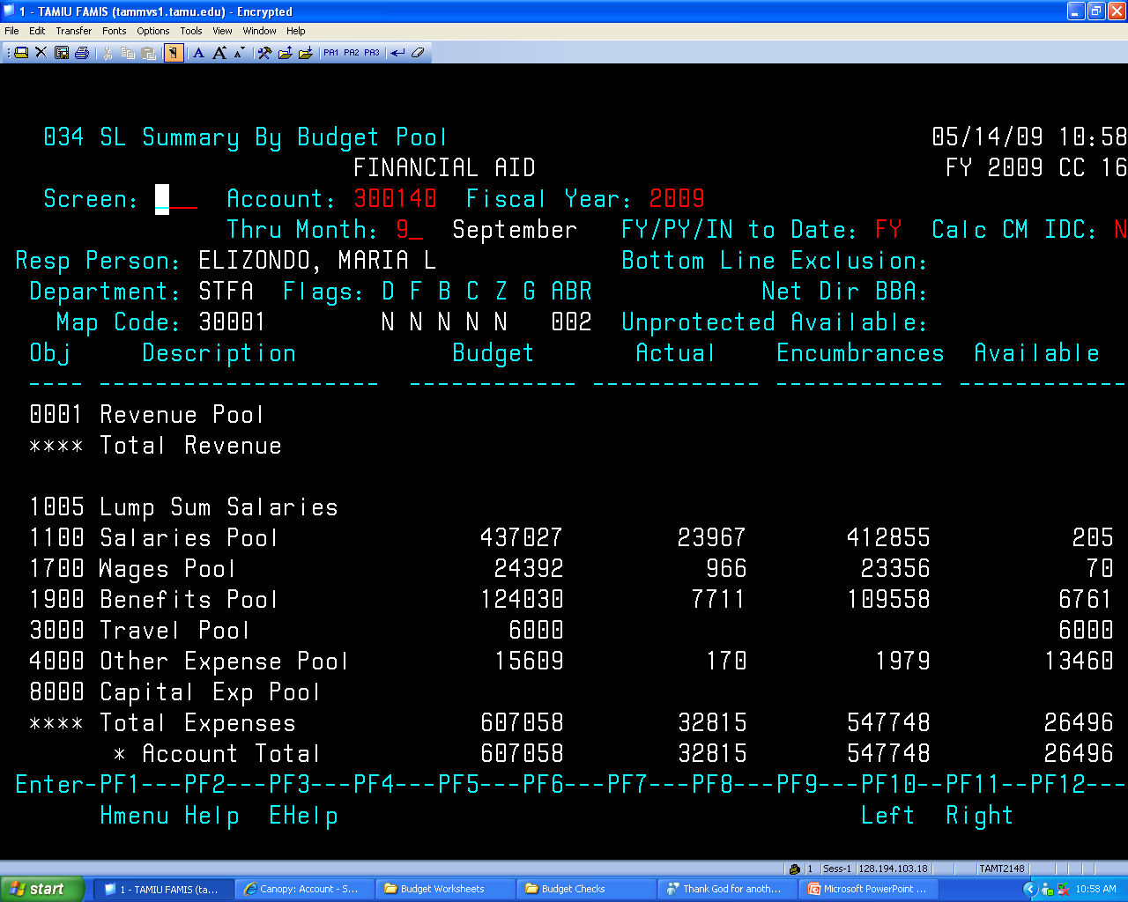

Slide 12
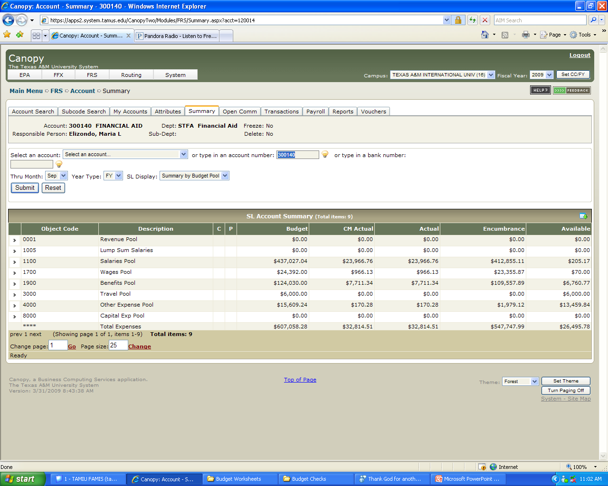

Slide 13
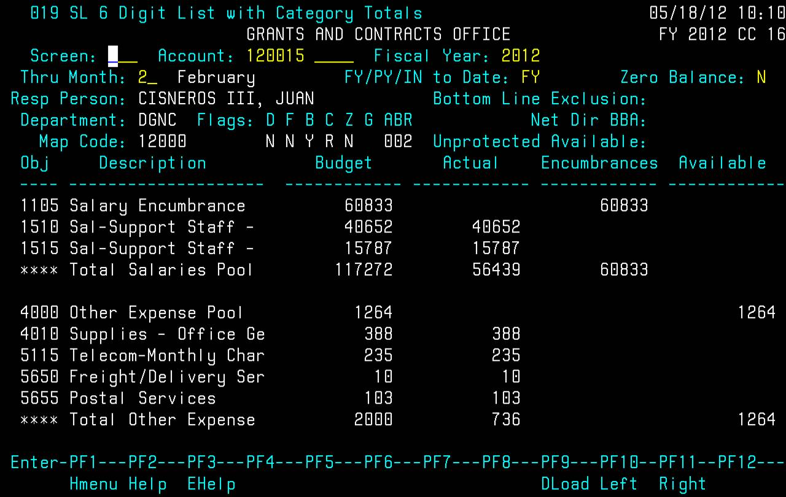

Slide 14
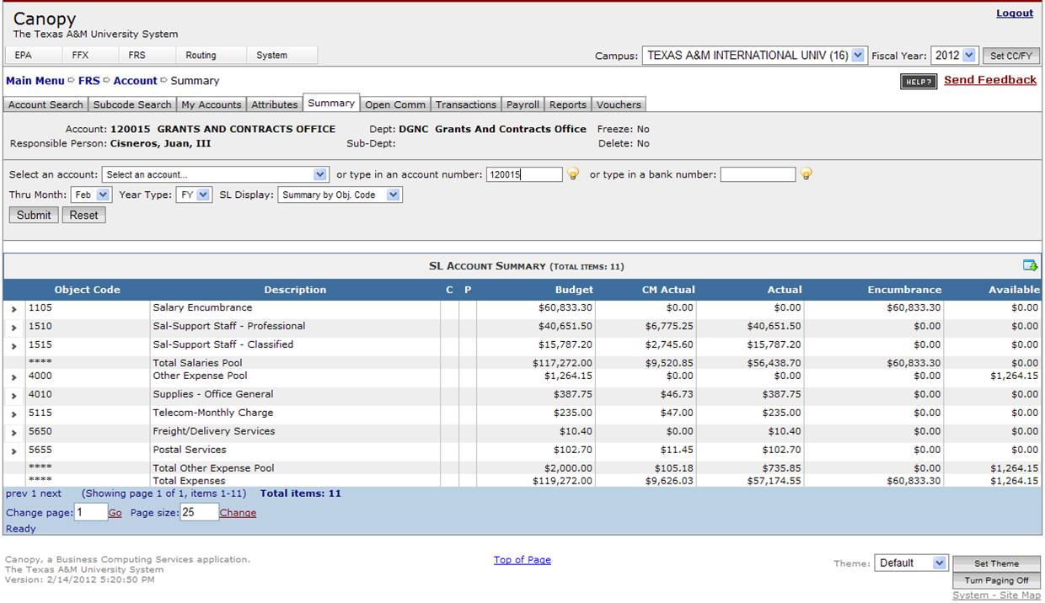

Slide 15
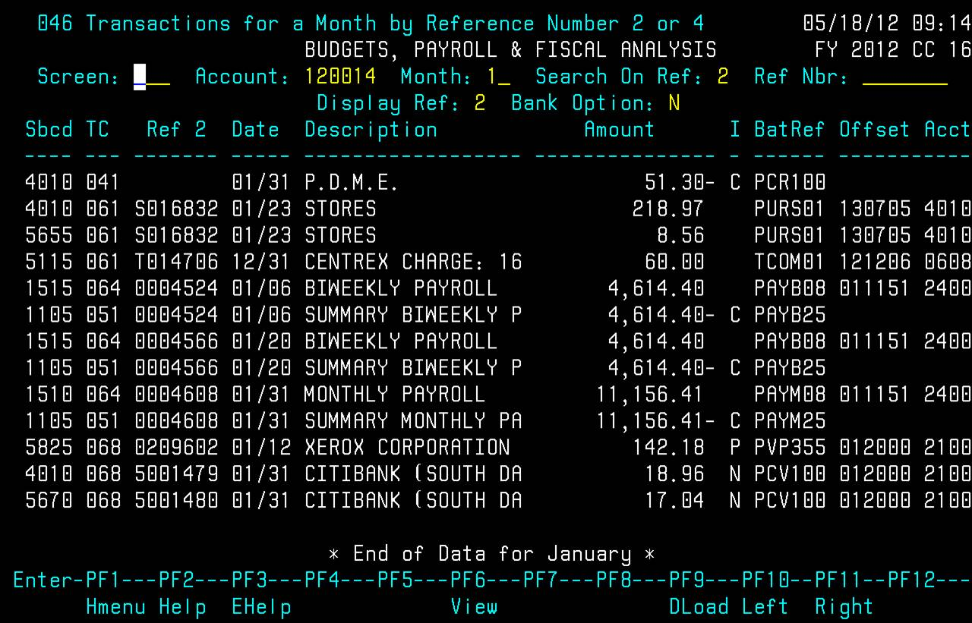

Slide 16
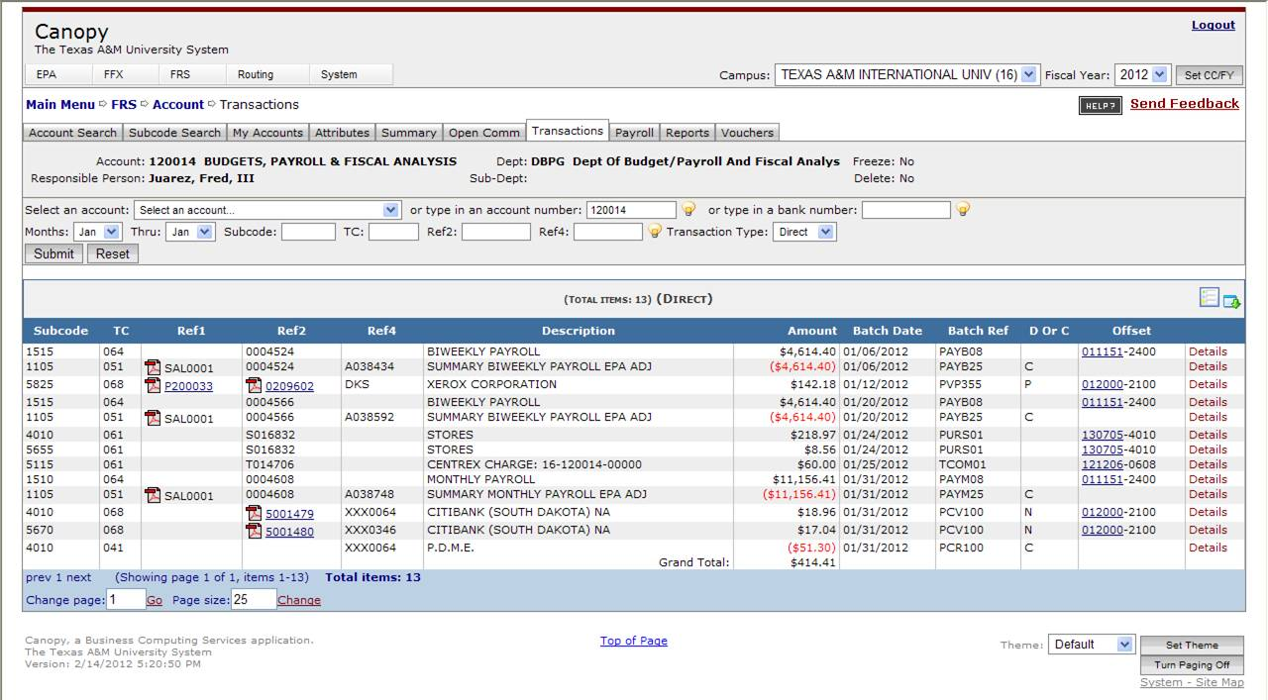

Slide 17
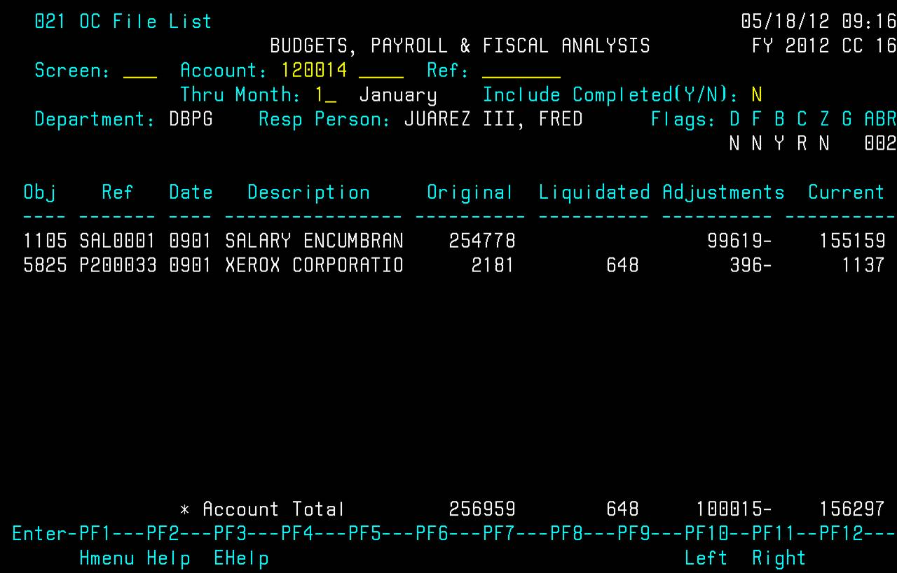

Slide 18
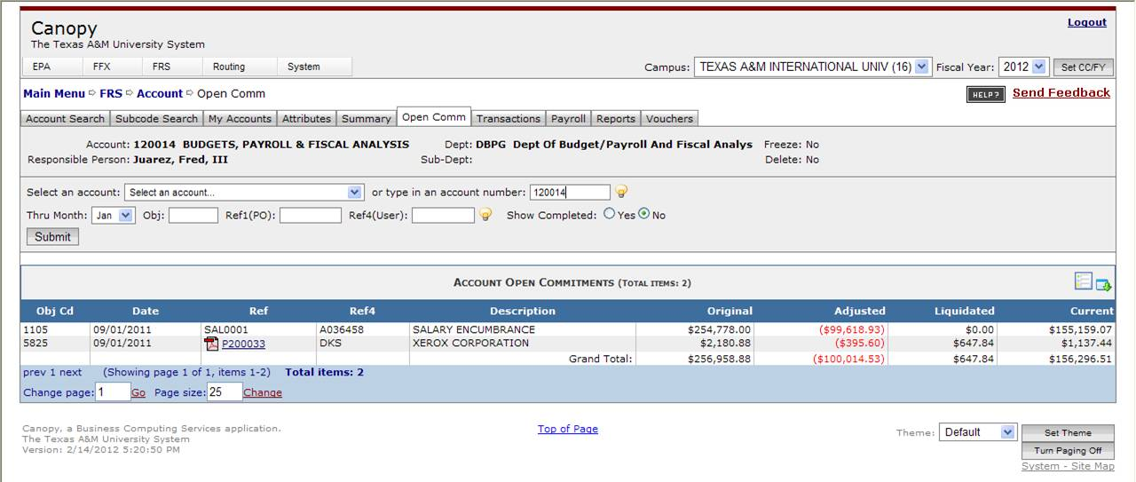

Slide 19
Request for Budget Transfers – Account to Account
  Transfers CANNOT be made between State and Local Accounts
  Transfers CANNOT be made between Compulsory Fees Accounts (Designated Tuition, Health Fee, Student Service, Athletic Fee, Etc.)
  When requesting transfers, account pools must be provided.
    Between what pools are you requesting a change?
    Transfer From: Transfer To:
    Account Pool Amount Account Pool Amount
    123456 3000 $1,000 123456 4000 $1,000

Slide 20
Request for Budget Transfers – Within an Account
  For transfers between:
    Salaries/Wages Travel/M&O
      Approval is needed by VP for Finance and Administration
      For transfers between:
    Salaries Wages
    Travel M&O
    M&O Travel
      Approval is only needed by Department Head

Slide 21
Commonly Used Object Codes
Travel
  In-state/Out-of-State
    5840 – Auto Rental
    3016/3116 – Mileage
    3025/3125 – Incidental Exp.
    3030/3130 – Meals/Lodging
Revenue Codes
  Because of recent changes, questions on Revenue Object Codes should be referred to: Elena Martinez, Comptroller, ext. 2433
Supplies
  4010 – Office Supplies
  4012 – Educ. Supplies
  4090 – Comp. Supplies
Equipment
  8421 – Office Furnishings & Equipment
For more information about object codes and their descriptions, visit –
http://apps.system.tamus.edu/objcodes/

Slide 22
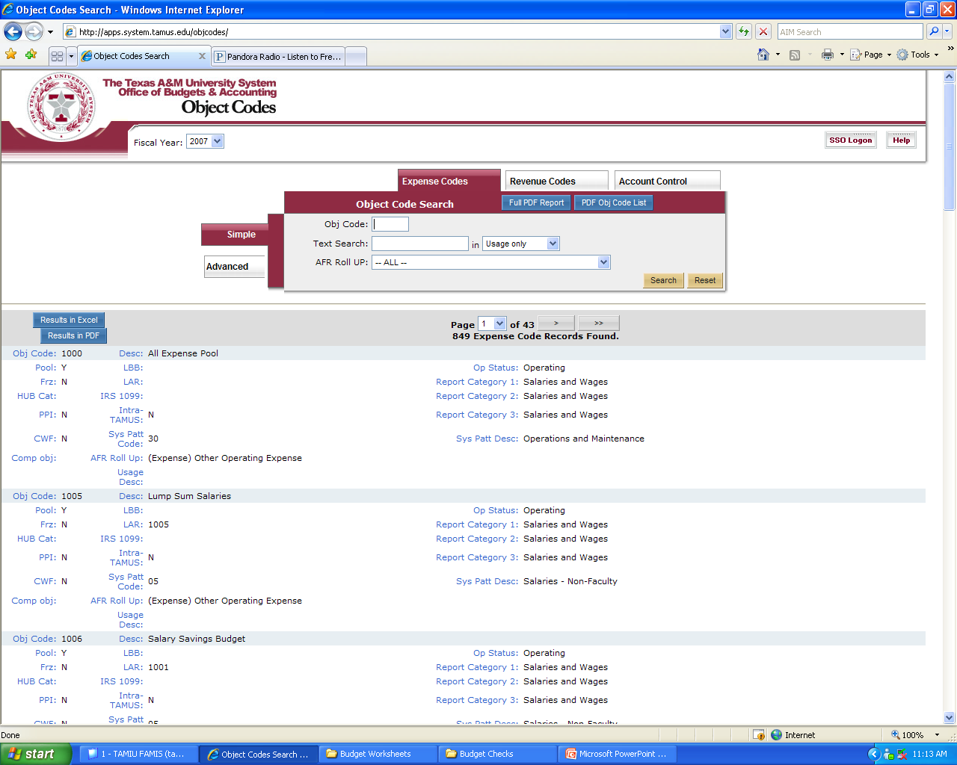

Slide 23
Questions ???

Slide 24
THANKS!!

